Slide 1
Process Control
Course II
Lecture 1
Closed Loop system

Slide 2
Outline
1- Open loop Vs closed loop system
2- Definition of closed loop system
3 -Variables in open loop and closed loop system
4- Components of closed loop system
5- Transfer function of closed loop
6- Regulator VS. Servo loop

Slide 3
Open loop VS. Closed loop system
Open loop system
In simple words
Open system is the system which is not under control. It means that To will be changed if any change occurs in T_{i} or Q or m.
As an example ,Let’s take the CSTH(continuous stirred tank heater)
m
T_{i}
cp
Variables
M
m
To
cp
Input variables
output variables
m
T_{i}
Q
T_{o}
Q
Fig.1 CSTH (open loop system)

Slide 4
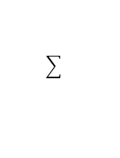
Transfer function of open loop
Previously we discussed the transfer function of the CSTH and we found that $To=f ( Ti, m,Q)$
$$To=\frac{k_{1}}{τs+1}T_{i}+\frac{k_{2}}{τs+1}Q−\frac{k_{3}}{τs+1}m$$
The signal flow Block diagram (SFBD)is shown in Fig.2
T_{i}(s)
$$\frac{k_{1}}{τs+1}$$
+
$$\frac{k_{2}}{τs+1}$$
+
Q(s)
$$\sum{1}$$
To(s)
-
m(s)
$$\frac{k_{3}}{τs+1}$$
Fig.2 SFBD for open system.

Slide 5
Closed loop system
In simple words
Closed system is the system which is under control. It means that To will remain constant if any change occurs in T_{i} or Q or m.
Components of closed system
1- Process
2- measuring element
3Comparator
4- Controller
5- Final Control Element (Control Valve)
m
cp
T_{i}
Temperature measuring element
M
Process
m
cp
T_{o}
Steam in
Q
Final control element
P
Controller
E
T_{m}
Control Valve
Comparator
T_{sp}
Fig.3 Closed System.

Slide 6
Variables in Closed loop System
Variables
Load variables
Manipulating variable
Controlled variable
m
T_{i}
Q
To

Slide 7
Signal Flow Block Diagram (SFBD) for closed system
T_{i}
Load 1
+
+
m
Load 2
∑∑
Σ
Controlled variable
Comparator
+
T_{sp}
+
E
P
Control valve
Q
+
∑
Controller
Process
∑
To
Set point
-
T_{m}
Measuring element
Measured variable
To

Slide 8
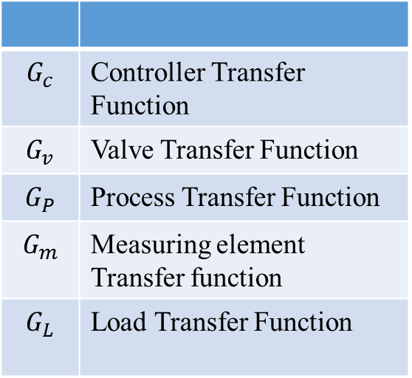
Signal flow block diagram always written in terms of transfer function as below
T_{i}
$$G_{L1}$$
+
m
$$G_{L2}$$
+
∑∑
Σ
Controlled variable
Comparator
+
Q
+
T_{sp}
E
P
+
∑
$$G_{c}$$
$$G_{v}$$
$$G_{P}$$
∑
To
Set point
-
T_{m}
$$G_{c}$$ | Controller Transfer Function
$$G_{v}$$ | Valve Transfer Function
$$G_{P}$$ | Process Transfer Function
$$G_{m}$$ | Measuring element Transfer function
$$G_{L}$$ | Load Transfer Function
$$G_{m}$$
Measured variable
To

Slide 9
Transfer function of closed loop
The transfer function of a closed system depends mainly upon Load variables and set point
Referring to the previous example of CSTH, we can construct three transfer functions as follows
$$G1\left(s\right)=\frac{T_{o}(s)}{T_{i}(s)} ,G2\left(s\right)=\frac{T_{o}(s)}{m (s)} , G3\left(s\right)=\frac{T_{o}(s)}{T_{sp}(s)}$$

Slide 10
T_{i} (s)
$$G_{L1}$$
+
m(s)
$$G_{L2}$$
+
∑∑
Σ
Controlled variable
Comparator
+
Q
+
T_{sp} (s)
E
P
+
∑
$$G_{c}$$
$$G_{v}$$
$$G_{P}$$
∑
To(s)
Set point
-
T_{m}
$$G_{m}$$
Measured variable
To
$$G1\left(s\right)=\frac{T_{o}(s)}{T_{i}(s)} = \frac{G_{L1}}{1+G_{c}G_{v }G_{P}G_{m}}$$
$$G2\left(s\right)=\frac{T_{o}(s)}{m (s)} = \frac{G_{L2}}{1+G_{c}G_{v }G_{P}G_{m}}$$
$$G3\left(s\right)=\frac{T_{o}(s)}{T_{sp}(s)} = \frac{G_{c}G_{v }G_{P}}{1+G_{c}G_{v }G_{P}G_{m}}$$

Slide 11
Derivation of Transfer function of a closed loop system
We try to derive the transfer function
$$G1\left(s\right)=\frac{T_{o}(s)}{T_{i}(s)}$$
T_{i} (s)
$$G_{L1}$$
Z2
Note that the only input variable is Ti
+
So, m and Tsp are both constants
m=0 and Tsp=0
m(s)
$$G_{L2}$$
+
∑∑
Σ
Z3
Controlled variable
Comparator
Z1
+
Q
+
T_{sp} (s)
E
P
+
∑
$$G_{c}$$
$$G_{v}$$
$$G_{P}$$
∑
To(s)
Set point
Z4
-
$$T_{o}\left(s\right)=Z1+Z4 ……(1)$$
T_{m}
$$Z1=Z3+Z2$$
$$G_{m}$$
Z1$=m\left(s\right).G_{L2}+T_{i}(s)G_{L1}$
Measured variable
To
Z1$=m\left(s\right).G_{L2}+T_{i}\left(s\right)G_{L1} but m\left(s\right)=0 constant$
Z1$= T_{i}\left(s\right)G_{L1} ………….. (2)$
Subs. Eq.(2) in (1) gives
$$T_{o}\left(s\right)=T_{i}\left(s\right)G_{L1}+Z4 ……(3)$$

Slide 12
$$T_{o}\left(s\right)=T_{i}\left(s\right)G_{L1}+Z4 ……(3)$$
T_{i} (s)
$$G_{L1}$$
Z2
$$Z4=G_{P}Q$$
+
$$Z4=G_{P}G_{v}p$$
+
∑∑
m(s)
$$G_{L2}$$
Σ
$Z4=G_{P}G_{v}G_{c}$ E
Z3
Controlled variable
$$Z4=G_{P}G_{v}G_{c} \left(T_{sp}−T_{m}\right)$$
$$but T_{sp}=0$$
Comparator
Z1
+
Q
+
T_{sp} (s)
E
P
+
∑
$$G_{c}$$
$$G_{v}$$
$$G_{P}$$
∑
To(s)
Set point
Z4
-
$$Z4={− G}_{P}G_{v}G_{c} T_{m} ………. \left(4\right)$$
Subs. Eq.(4) in (3) gives
T_{m}
$$G_{m}$$
$$T_{o}\left(s\right)=T_{i}\left(s\right)G_{L1}{− G}_{P}G_{v}G_{c} T_{m} ……(5)$$
Measured variable
To
$$T_{o}\left(s\right)=T_{i}\left(s\right)G_{L1}{− G}_{P}G_{v}G_{c}G_{m}T_{o}(s)$$
$$T_{o}\left(s\right)(1+{ G}_{P}G_{v}G_{c}G_{m})=T_{i}\left(s\right)G_{L1}$$
$$\frac{T_{o}\left(s\right)}{T_{i}\left(s\right)}= \frac{G_{L1}}{1+{ G}_{P}G_{v}G_{c}G_{m}}$$
$$G_{1}\left(s\right)=\frac{T_{o}\left(s\right)}{T_{i}\left(s\right)}= \frac{G_{L1}}{1+{ G}_{P}G_{v}G_{c}G_{m}}$$
In the same way, we can derive the other two transfer functions.
$$G2\left(s\right)=\frac{T_{o}(s)}{m (s)} = \frac{G_{L2}}{1+G_{c}G_{v }G_{P}G_{m}}$$
$$G3\left(s\right)=\frac{T_{o}(s)}{T_{sp}(s)} = \frac{G_{c}G_{v }G_{P}}{1+G_{c}G_{v }G_{P}G_{m}}$$
and

Slide 13
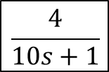
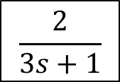
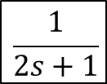
Example 1: A closed loop system consists of the following items:
- Process: $y\left(s\right)=f \left(x\left(s\right), z\left(s\right)\right) where x\left(s\right)is load variable and z\left(s\right)is manipulating variable.$
$y\left(s\right)=\frac{2}{3s+1}x\left(s\right)+ \frac{4}{10s+1}z(x)$
- Controller transfer function: $Gc\left(s\right)=0.2$
- Valve transfer function: $Gv\left(s\right)=2$
- Measurement transfer function: $Gm\left(s\right)=\frac{1}{2s+1}$
Construct the signal flow block diagram (SFBD) for the closed system.
Solution
X(s)
$$\frac{2}{3s+1}$$
+
y_{sp} (s)
+
E
P
Z
$$\frac{4}{10s+1}$$
+
∑
$$0.2$$
$$2$$
∑
y(s)
Set point
-
y_{m}
y
$$\frac{1}{2s+1}$$

Slide 14
Regulator VS. Servo loop
Regulator Loop: It is a closed loop in which the load is varied and the set point is constant.
Servo Loop: It is a closed loop in which set point is varied and the load is constant.
Consider the closed loop shown below
X(s)
$$Gl(s)$$
+
y_{sp} (s)
+
E
P
Z
+
∑
$$Gc(s)$$
$$Gv(s)$$
$$Gp(s)$$
∑
y(s)
Set point
-
y_{m}
y
$$Gm(s)$$
For the regulator loop, the transfer function is
$$G\left(s\right)=\frac{y(s)}{x(s)}= \frac{Gl(s) }{1+Gc(s)Gv(s)Gp(s)Gm(s) }$$
For the Servo loop, the transfer function is
$$G\left(s\right)=\frac{y(s)}{y_{sp}(s)}= \frac{Gc(s)Gv(s)Gp(s)}{1+Gc(s)Gv(s)Gp(s)Gm(s) }$$

Slide 15
Example 2
A close loop system in which the output variable $θ_{o}$ is function of both load variable$θ_{L}$ and
the set point $θ_{sp}$. i.e. $θ_{o}=f(θ_{L},θ_{sp})$. The system has the following elements with their transfer functions:
Process : $G_{p}\left(s\right)=\frac{3}{10s+1}$
Load : $G_{L}\left(s\right)=\frac{1}{10s+1}$
Measurement : $G_{m}\left(s\right)=1$
Control Valve : $Gv\left(s\right)=1.5$
Controller : $G_{c} \left(s\right)=2$
Draw the block diagram for this closed loop.
Find the transfer function if the system operates as servo.
Find the transfer function if the system operates as regulator.
Find the response, if a unit step change occurs in the load and sketch it.

Slide 16
Solution
a. The block diagram is shown below
$θL$(s)
$$\frac{1}{10S+1}$$
+
$θsp$(s)
+
+
∑
$$2$$
$$1.5$$
$$\frac{3}{10S+1}$$
∑
$θ$(s)
_
$$1$$
b. Transfer function for Servo problem
$G\left(s\right)=\frac{θ \text{(}\text{s})}{θsp \text{(}\text{s}\text{) }}=\frac{2(1.5)(\frac{3}{10s+1)}}{1+2(1.5)(\frac{3}{10s+1)}(1)}$ = $\frac{0.9}{s+1}$

Slide 17
c. Transfer function for Regular problem
$$G\left(s\right)=\frac{θ \text{(}\text{s})}{θL \text{(}\text{s}\text{) }}=\frac{(\frac{1}{10s+1})}{1+2(1.5)(\frac{3}{10s+1)}(1)}=\frac{1}{10(s+1)}=\frac{0.1}{(s+1)}$$
d. For a unit step change in load of value =1, $θ_{L}\left(s\right)=\frac{1}{s}$
$θ_{o}\left(t\right)=ℒ^{−1}\frac{0.1}{s(s+1)}=0.1(1−e^{−t}$)
$$0.1$$
$$θ_{o}(t)$$
0
$$t$$

Slide 18
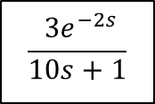
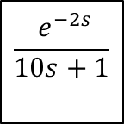
Example 3
A closed loop system has the following items;
Process : $G_{p}\left(s\right)=\frac{3 e^{−2s}}{10s+1}$ , Load : $G_{L}\left(s\right)=\frac{e^{−2s}}{10s+1}$ , Measurement: $G_{m}\left(s\right)=1$, Valve: $Gv\left(s\right)=1.5$ , $Gc\left(s\right)=2$
The output variable (controlled variable) $θ_{o}$ is function of load variable $θ_{L}$ and set point $θ_{sp}$ , $θ_{o}=f(θ_{L},θ_{sp})$.
Draw the signal flow block diagram.
b. Determine the system response for a unit step in load variable
$$\frac{ e^{−2s}}{10s+1}$$
$θL$(s)
Solution
+
$θsp$(s)
+
a.
$$2$$
$$1.5$$
$$\frac{ {3e}^{−2s}}{10s+1}$$
$θ$(s)
_
∑
+
∑
$$1$$

Slide 19


The change occurs in load variable, so the system is regulator problem.
$$θ_{o}\left(s\right)=\frac{G_{L}\left(s\right)}{1+ G_{c}\left(s\right). G_{v}\left(s\right)G_{p}(s)G_{m}(s)} θL\left(s\right)$$
$$G\left(s\right)=\frac{θ_{o}\left(s\right)}{θL\left(s\right)}=\frac{\frac{ e^{−2s}}{10s+1}}{1+2(1.5)( \frac{3e^{−2s}}{10s+1} )}$$
$$\frac{ e^{−2s}}{10s+1}$$
$θL$(s)
+
$θsp$(s)
+
$$2$$
$$1.5$$
$$\frac{ {3e}^{−2s}}{10s+1}$$
$θ$(s)
_
∑
+
∑
$$1$$
using pade approximation $e^{−τ_{D}}=\frac{1−0.5 τ_{D}S}{1+0.5τ_{D}S}= \frac{1−0.5(2)s}{1+0.5(2)s}= \frac{1−s}{1+s}$
$$G\left(s\right)=\frac{\frac{ e^{−2s}}{10s+1}}{1+ \frac{2\left(1.5\right)\left(3\right)e^{−2s}\left(1\right)}{10s+1}}= \frac{\frac{1−s}{\left(1+s)(10s+1\right)}}{1+\frac{\left.9( \frac{1−s}{1+s} \right)}{10s+1}}$$

Slide 20
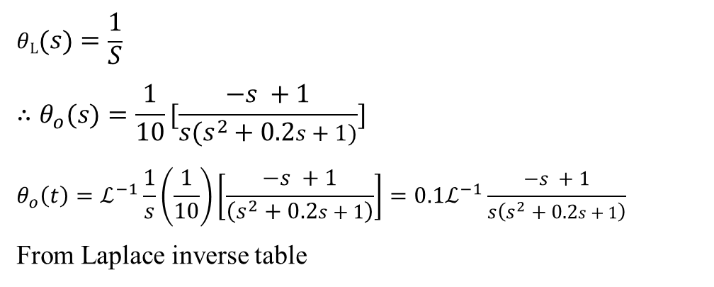
$$G\left(s\right)=0.1[\frac{\left(−s +1\right)}{\left(s^{2}+0.2s+1\right)}]$$
$$θL\left(s\right)=\frac{1}{S}$$
$$∴θ_{o}(s)=\frac{1}{10}[\frac{−s +1}{s(s^{2}+0.2s+1)}]$$
$$θ_{o}\left(t\right)=ℒ^{−1}\frac{1}{s}\left(\frac{1}{10}\right)\left[\frac{−s +1}{\left(s^{2}+0.2s+1\right)}\right]=0.1ℒ^{−1}\frac{−s +1}{s\left(s^{2}+0.2s+1\right)}$$
From Laplace inverse table
$${∴θ}_{o}\left(t\right)=ℒ^{−1} \frac{T_{1}s+1}{s\left(T^{2}s^{2}+2δTs+1\right)}=1+\frac{1}{A}{\left[1−2T_{1}c+{\left(\frac{T_{1}}{T}\right)}^{2}\right]}^{\frac{1}{2}}e^{−ct}\sin\left(Bt−∅\right)$$
$$∅=\tan^{−1}\left[\frac{T_{1}B}{1− T_{1}c}\right]−\tan^{−1}\left(\frac{A}{−δ}\right)$$
$T_{1}=−1, T=1,δ=0.1$
$A= \sqrt{1−δ^{2}}=0.994, B=\frac{\sqrt{1−δ^{2}}}{T}=0.994 , c=\frac{δ}{A}=0.1$
$$∴∅=0.736$$
من جدول تحويلات لابلاس

Slide 21
$${∴θ}_{o}\left(t\right)=\frac{1}{10}[1+\frac{1}{0.994}{\left[1−2(−1)(0.1)+{\left(\frac{−1}{2}\right)}^{2}\right]}^{\frac{1}{2}}e^{−(0.1)t}\sin\left(0.994t−0.736\right)$$
$$=0.1 \left[1+1.49e^{−\left(0.1\right)t}\sin\left(0.994t−0.736\right)\right]$$
$$θ_{o}\left(t\right)=0.1+0.149 e^{−0.1t}\sin\left(0.994t−0.736\right)$$

